Slide 1
Machine Learning Techniques (16CSE09)
Unit – 1 / Sessions 9
Topics:
Statistical Learning
History of Statistical Learning
Example for Statistical Learning
Function Estimation
Access Model Accuracy

Slide 2
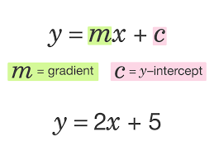
Why Estimate f?
There are two main reasons that we may wish to estimate f:
Prediction
Inference

Slide 3
Why Estimate f?
Prediction
In many situations, a set of inputs X are readily available, but the output Y cannot be easily obtained.
we can predict Y using (error term averages to zero), ˆY = ˆf(X),
where ˆf represents our estimate for f, and ˆY represents the resulting prediction for Y.

Slide 4
Prediction (con… )
Example: suppose that X1, . . .,Xp are characteristics of a patient’s blood sample that can be easily measured in a lab, and Y is a variable encoding the patient’s risk for a severe adverse reaction to a particular drug.
It is natural to seek to predict Y using X, since we can then avoid giving the drug in question to patients who are at high risk of an adverse reaction—that is, patients for whom the estimate of Y is high.
The accuracy of ˆY as a prediction for Y depends on two quantities, which we will call the reducible error and the irreducible error.

Slide 5
Prediction (con… )
In general, ˆf will not be a perfect estimate for f, and this inaccuracy will introduce some error. This error is reducible because we can potentially improve the accuracy of ˆf by using the most appropriate statistical learning technique to estimate f.
Reducible error is the error arising from the mismatch between f̂ and f. f is the true relationship between X and Y, but we can't see f directly - we can only estimate it. We can reduce the gap between our estimate and the true function by applying improved methods

Slide 6
Prediction (con… )
However, even if it were possible to form a perfect estimate for f, so that our estimated response took the form ˆY = f(X), our prediction would still have some error in it.
This is because Y is also a function of ϵ, which, by definition, cannot be predicted using X. Therefore, variability associated with ϵ also affects the accuracy of our predictions. This is known as the irreducible error, because no matter how well we estimate f, we cannot reduce the error introduced by .
Irreducible error is the error that can't be reduced by creating good models. It is a measure of the amount of noise in our data. Here it is important to understand that no matter how good we make our model, our data will have certain amount of noise or irreducible error that can not be removed.

Slide 7
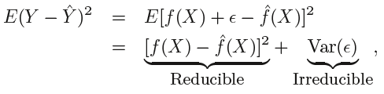
Prediction (con… )
Consider a given estimate ˆf and a set of predictors X, which yields the prediction ˆY = ˆf(X).
Assume for a moment that both ˆf and X are fixed.
Then, it is easy to show that,
where E(Y − ˆY )² represents the average, or expected value, of the squared difference between the predicted and actual value of Y, and Var(ϵ) represents the variance associated with the error term .

Slide 8
Why Estimate f?
Inference
We are often interested in understanding the way that Y is affected as X1, . . . , Xp change. In this situation we wish to estimate f, but our goal is not necessarily to make predictions for Y.
We instead want to understand the relationship between X and Y, or more specifically, to understand how Y changes as a function of X1, . . .,Xp.
In this setting, one may be interested in answering the following questions:
1. Which predictors are associated with the response?
  Identifying the few important predictors among a large set of possible variables can be extremely useful, depending on the application

Slide 9
Inference (cont…)
2. What is the relationship between the response and each predictor?
Some predictors may have a positive relationship with Y, in the sense that increasing the predictor is associated with increasing values of Y . Other predictors may have the opposite relationship
3. Can the relationship between Y and each predictor be adequately summarized using a linear equation, or is the relationship more complicated?
Historically, most methods for estimating f have taken a linear form.
In some cases a linear model may not provide an accurate representation of the relationship between the input and output variables.

Slide 10
Example: Prediction
consider a company that is interested in conducting a direct-marketing campaign
The goal is to identify individuals who will respond positively to a mailing, based on observations of demographic variables measured on each individual.
In this case, the demographic variables serve as predictors, and response to the marketing campaign (either positive or negative) serves as the outcome.
The company is not interested in obtaining a deep understanding of the relationships between each individual predictor and the response; instead, the company simply wants an accurate model to predict the response using the predictors

Slide 11
Example: Inference
Consider the Advertising data (TV, Radio, & News Paper)
One may be interested in answering questions such as:
Which media contribute to sales?
Which media generate the biggest boost in sales? or
How much increase in sales is associated with a given increase in TV advertising?
Consider modeling the brand of a product
a customer might purchase based on variables such as price, store location, discount levels, competition price, and so forth.
In this situation one might really be most interested in how each of the individual variables affects the probability of purchase.
For instance, what effect will changing the price of a product have on sales?

Slide 12
Example: Both Prediction & Inference
Some modeling could be conducted both for prediction and inference
Example: real estate
Seek to relate values of house to inputs such as crime rate, zoning, distance from a river, air quality, schools, income level of community, size of houses, and so forth.
In this case, one might be interested in how the individual input variables affect the prices. i.e, how much extra will a house be worth if it has a view of the river? This is an inference problem.
Alternatively, one may simply be interested in predicting the value of a home given its characteristics: is this house under- or over-valued? This is a prediction problem.

Slide 13
Functions to Estimate f
Depending on whether our ultimate goal is prediction, inference, or a combination of the two, different methods for estimating f may be appropriate.
linear models: simplest class of algorithms and interpretable inference - may not yield as accurate predictions
non-linear approaches: provide quite accurate predictions for Y - less interpretable model (inference is more challenging)

Slide 14
Function Estimation / How Do We Estimate f?
Apply Learning method over training data to estimation unknown function f.
Two Major Approaches:
Parametric
  Assume function form
  Train and compute parameters
Non-parametric
  No Assumption
  Estimate f close to data points

Slide 15

Parametric Methods
Parametric methods involve a two-step model-based approach
First, we make an assumption about the functional form, or shape, of f. For example, one very simple assumption is that f is linear in X:
Once we have assumed that f is linear, the problem of estimating f is greatly simplified
After a model has been selected, we need a procedure that uses the training data to fit or train the model. we need to estimate the parameters β₀, β ₁ , . . . , β_{p}. That is, we want to find values of these parameters such that,
The most common approach to fitting this model is referred to as (ordinary) least squares

Slide 16
Parametric Methods
Benefits:
  Simpler and easier to understand; easier to interpret the results
  Faster when talking about learning from data
  Less training data required to learn the mapping function, working well even if the fit to data is not perfect
Limitations:
  Highly constrained to the specified form of the simplified function
  Limited complexity of the problems they are suitable for
  Poor fit in practice, unlikely to match the underlying mapping function.
more examples of parametric machine learning algorithms include:
  Logistic Regression
  Linear Discriminant Analysis
  Perceptron
  Naive Bayes
  Simple Neural Networks

Slide 17
Example of the parametric approach applied to the
Income data
We have fit a linear model of the form,
Since we have assumed a linear relationship between the response and the two predictors, the entire fitting problem reduces to estimating β₀ , β₁ , and β₂ which we do using least squares linear regression.

Slide 18
Non-parametric Methods
Non-parametric algorithms do not make assumptions regarding the form of the mapping function (f) between input data and output. Consequently, they are free to learn any functional form from the training data.
A simple example is the K-nearest neighbors (KNN) algorithm, KNN does not make any assumptions about the functional form, but instead uses the pattern that points have similar output when they are close.
more examples of popular nonparametric machine learning algorithms are:
  k-Nearest Neighbors
  Decision Trees like CART and C4.5
  Support Vector Machines

Slide 19
Non-parametric Methods
Benefits:
  High flexibility, in the sense that they are capable of fitting a large number of functional forms
  Power by making weak or no assumptions on the underlying function
  High performance in the prediction models that are produced
Limitations:
  More training data is required to estimate the mapping function
  Slower to train, generally having far more parameters to train
  Overfitting the training data is a risk; overfitting makes it harder to explain the resulting predictions

Slide 20
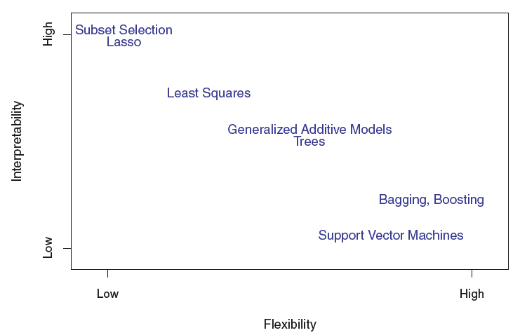
A representation of the tradeoff between flexibility and interpretability, using different statistical learning methods. In general, as the flexibility of a method increases, its interpretability decreases.

Slide 21
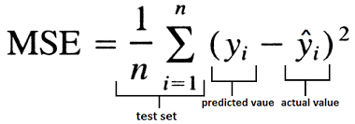
Access Model Accuracy
Determine how well predicted value matches with observed data
Mean Square Error (MSE)
  MSE= 1/n ( Actual- Predicted)^2; where n is the no. of data points
  Good if MSE is small
  Poor if MSE is large
Issue: Overfitting and Underfitting
Overfitting : Large training set and small test set
Underfitting : Small training set and large test set

Slide 22
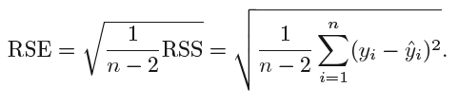

Access Model Accuracy
Residual Standard Error (RSE)
Due to the presence of these error terms, even if we knew the true regression line (i.e. even if β₀ and β₁ were known), we would not be able to perfectly predict Y from X.
The RSE is an estimate of the standard deviation of ϵ. It is the average amount that the response will deviate from the true regression line. It is computed using the formula
RSS is given by,

Slide 23
Residual Standard Error
The RSE is considered a measure of the lack of fit of the model to the data
If the predictions obtained using the model are very close to the true outcome values —that is, if ˆyi ≈ yi for i = 1, . . . , n - then will be small, and we can conclude that the model fits the data very well.
On the other hand, if ˆyi is very far from yi for one or more observations, then the RSE may be quite large, indicating that the model doesn’t fit the data well.

Slide 24


R² Statistic
The RSE provides an absolute measure of lack of fit of the model to the data. But since it is measured in the units of Y , it is not always clear what constitutes a good RSE.
The R² statistic provides an alternative measure of fit. It takes the form of a proportion—the proportion of variance explained—and so it always takes on a value between 0 and 1, and is independent of the scale of Y .
To calculate R², we use the formula,
where TSS is the Total Sum of Squares.

Slide 25
R² Statistic
An R² statistic that is close to 1 indicates that a large proportion of the variability in the response has been explained by the regression. A number near 0 indicates that the regression did not explain much of the variability in the response; this might occur because the linear model is wrong.
However, it can still be challenging to determine what is a good R² value, and in general, this will depend on the application. For instance, in certain problems in physics, we may know that the data truly comes from a linear model with a small residual error. In this case, we would expect to see an R2 value that is extremely close to 1, and a substantially smaller R² value might indicate a serious problem with the experiment in which the data were generated.
On the other hand, in typical applications in biology, psychology, marketing, and other domains, the linear model is at best an extremely rough approximation to the data, and residual errors due to other unmeasured factors are often very large. In this setting, we would expect only a very small proportion of the variance in the response to be explained by the predictor, and an R² value well below 0.1 might be more realistic

Slide 26

The R² statistic is a measure of the linear relationship between X and Y . Recall that correlation, defined as,
is also a measure of the linear relationship between X and Y
We can able to use r = Cor(X, Y ), instead of R² in order to assess the fit of the linear model. In the simple linear regression setting, R² = r² .
multiple linear regression problem: we use several predictors simultaneously to predict the response. The concept of correlation between the predictors and the response does not extend automatically to this setting, since correlation quantifies the association between a single pair of variables rather than between a larger number of variables. But R² fills this role.

Slide 27
Summary
Statistical Machine Learning
Function Estimation
Measuring the accuracy of model
Thank You…

